Slide 1
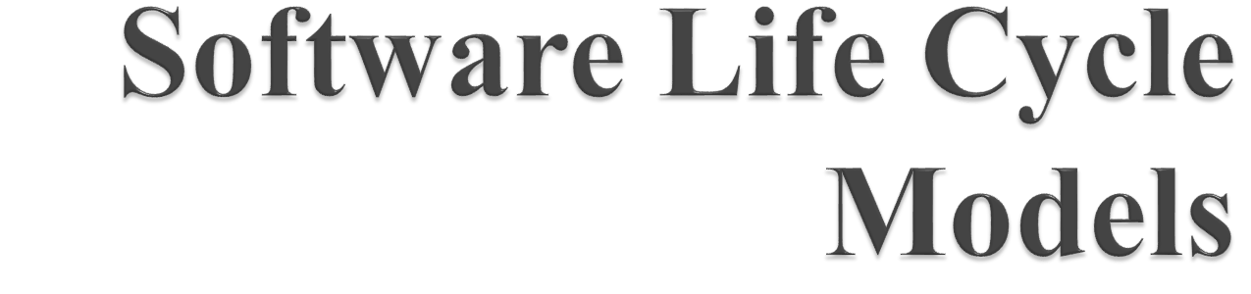

Slide 2
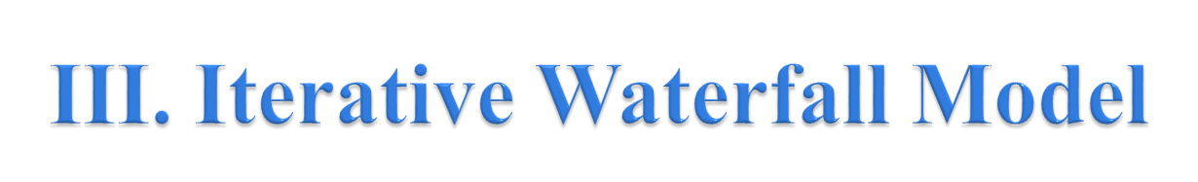
The classical waterfall model is hard to use. So, Iterative waterfall model can be thought of as incorporating the necessary changes to the classical waterfall model to make it usable in practical software development projects. It is almost same as the classical waterfall model except some changes are made to increase the efficiency of the software development.
The iterative waterfall model provides feedback paths from every phase to its preceding phases, which is the main difference from the classical waterfall model.

Slide 3

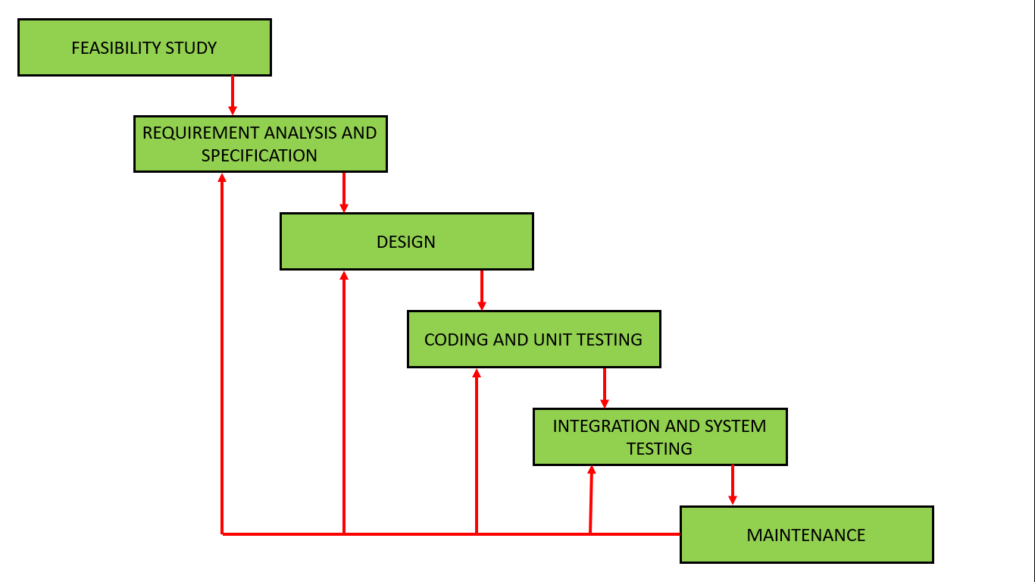
The iterative waterfall model provides feedback paths from every phase to its preceding phases, which is the main difference from the classical waterfall model.

Slide 4

The main focus of this phase is to determine whether it would be financially and technically feasible to develop the software.
The feasibility study involves carrying out several activities such as collection of basic information relating to the software such as
the different data items that would be input to the system,
the processing required to be carried out on these data,
the output data required to be produced by the system,
Various constraints on the development

Slide 5

The feedback paths allow the phase to be reworked in which errors are committed and these changes are reflected in the later phases. But, there is no feedback path to the stage – feasibility study, because once a project has been taken, does not give up the project easily.
It is good to detect errors in the same phase in which they are committed. It reduces the effort and time required to correct the errors.

Slide 6

Feedback Path: In the classical waterfall model, there are no feedback paths, so there is no mechanism for error correction. But in iterative waterfall model feedback path from one phase to its preceding phase allows correcting the errors that are committed and these changes are reflected in the later phases.
Simple: Iterative waterfall model is very simple to understand and use. That’s why it is one of the most widely used software development models.

Slide 7

Difficult to incorporate change requests: The major drawback of the iterative waterfall model is that all the requirements must be clearly stated before starting of the development phase. Customer may change requirements after some time but the iterative waterfall model does not leave any scope to incorporate change requests that are made after development phase starts.
Incremental delivery not supported: In the iterative waterfall model, the full software is completely developed and tested before delivery to the customer. There is no scope for any intermediate delivery. So, customers have to wait long for getting the software.

Slide 8
Overlapping of phases not supported: Iterative waterfall model assumes that one phase can start after completion of the previous phase, But in real projects, phases may overlap to reduce the effort and time needed to complete the project.
Risk handling not supported: Projects may suffer from various types of risks. But, Iterative waterfall model has no mechanism for risk handling.

Slide 9
Limited customer interactions: Customer interaction occurs at the start of the project at the time of requirement gathering and at project completion at the time of software delivery. These fewer interactions with the customers may lead to many problems as the finally developed software may differ from the customers’ actual requirements.

Slide 10
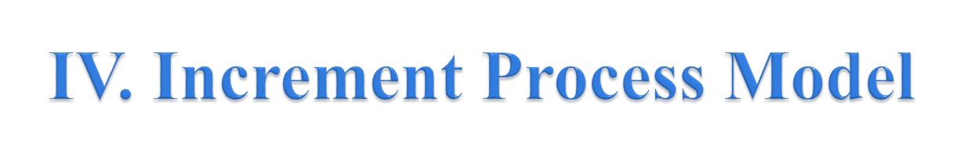
Incremental process model is also know as Successive version model.
First, a simple working system implementing only a few basic features is built and then that is delivered to the customer. Then thereafter many successive iterations/ versions are implemented and delivered to the customer until the desired system is released.

Slide 11
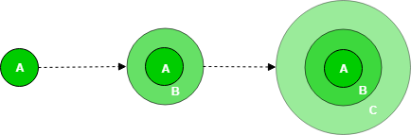
A, B, C are modules of Software Product that are incrementally developed and delivered.

Slide 12
Life cycle activities –
Requirements of Software are first broken down into several modules that can be incrementally constructed and delivered. At any time, the plan is made just for the next increment and not for any kind of long term plans. Therefore, it is easier to modify the version as per the need of the customer. Development Team first undertakes to develop core features (these do not need services from other features) of the system.
Once the core features are fully developed, then these are refined to increase levels of capabilities by adding new functions in Successive versions. Each incremental version is usually developed using an iterative waterfall model of development.
As each successive version of the software is constructed and delivered, now the feedback of the Customer is to be taken and these were then incorporated in the next version. Each version of the software have more additional features over the previous ones.

Slide 13
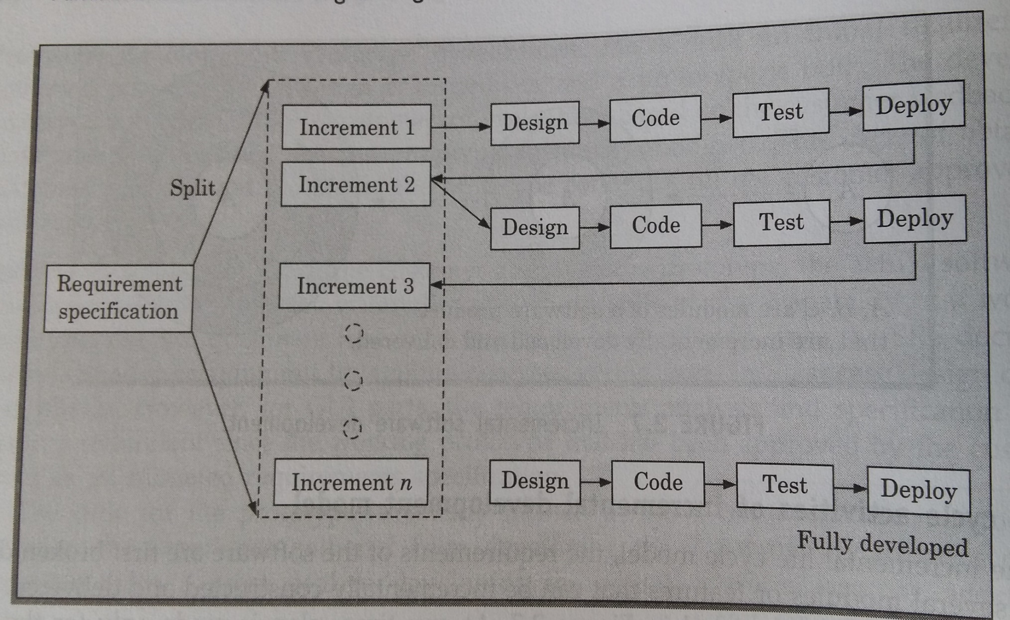

Slide 14

Error Reduction: The core modules are used by the customer from the beginning and therefore these get tested thoroughly. This reduces chances of errors in the core modules of the final product, leading to greater reliability of the software.
Incremental Resource Deployment: This model obviates the need for the customer to commit large resources at one go for development of the system. It also saves the developing organisation from deploying large resources and manpower for a project in one go.

Slide 15

Requires good planning and design.
Total cost is not lower.
Well defined module interfaces are required.

